Slide 1

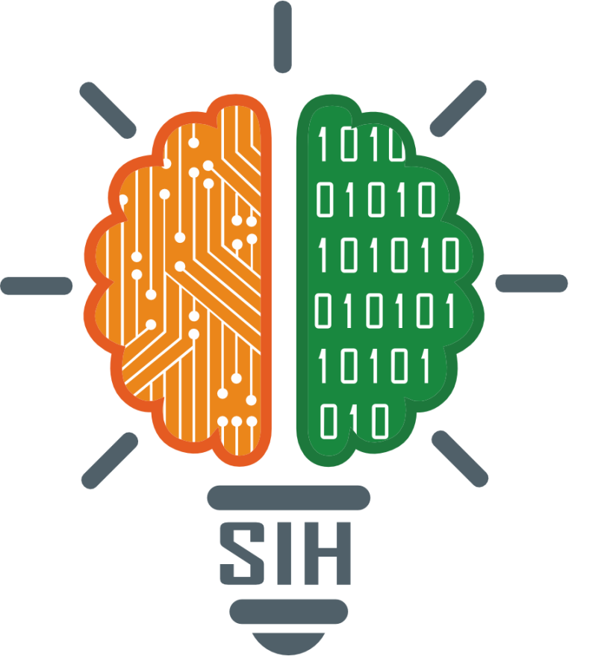
SMART INDIA HACKATHON 2025
Problem Statement ID – 25045
Problem Statement Title- Blockchain-Based Supply Chain Transparency for Agricultural Produce
Theme- Agriculture, Food Tech & Rural Development
PS Category- Software
Team ID- 195
Team Name : Hack Morph
Team Members
Omkar Gulve | Mahesh Khose
Jay Matere | Apurva Patil
Sarthak Salokhe | Viraj Patil

Slide 2
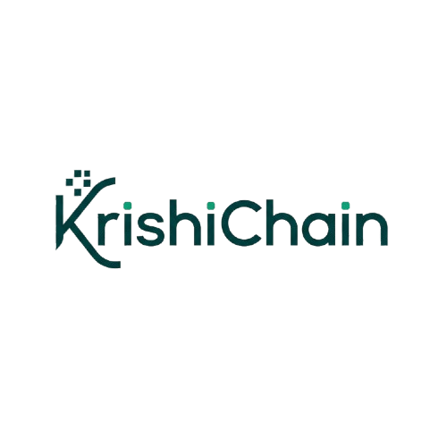
Blockchain based food authentication and supply chain transparency
Hack Morph
Empowering farmers with blockchain, sustainable agriculture
Problem Overview:
1.Lack of transparency in food supply chains leads to:
Farmer exploitation (low payouts)
Price inflation at consumer end
Misinformation about food origin and quality.
2.Manual record-keeping enables fraud, inefficiencies, and lack of trust.
Farmer Product. Product Details
Data entry on Blockchain(origin,details,Quality )
Processing / Packaging (Batch Info, Date)
Distribution & Logistics,Orders (Transport )
Consumer Scans QR Code (Mobile App)
Transparent & Trustworthy Food Authentication
Retail (Inventory Entry, QR Code for Consumers)
Proposed Solution:
Public Ledger(accessible to all)
1.A blockchain-based system that tracks agricultural produce from farm to the customer, ensuring all stakeholders have real-time access to verified, immutable data.
2.User-friendly dashboard for farmers and Consumers.
3.Ledger is a blockchain-based digital platform that enables transparent, tamper-proof, and real-time tracking of agricultural produce from the point of harvest (farm) to the point of sale (consumer).
4.This system is designed to empower farmers, build trust among stakeholders, and reduce inefficiencies and scams in the agricultural supply chain.
Workflow
Farmer
Blockchain Entry
Distributor Update
Update
Consumer Scan QR
View Complete History
Retailer
Improvements:
Blockchain-based system to verify authenticity images and Q
QR/NFC tags for traceability from farm to customer .
AI-chat Bot for Farmers to help the user to guide the farmer.
Prize prediction model.
Graphical representation for better understanding.

Slide 3
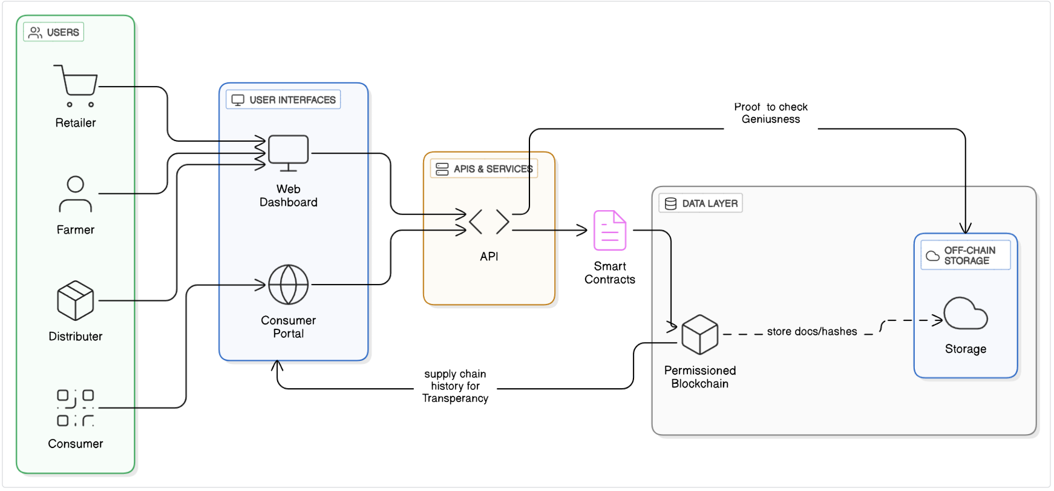
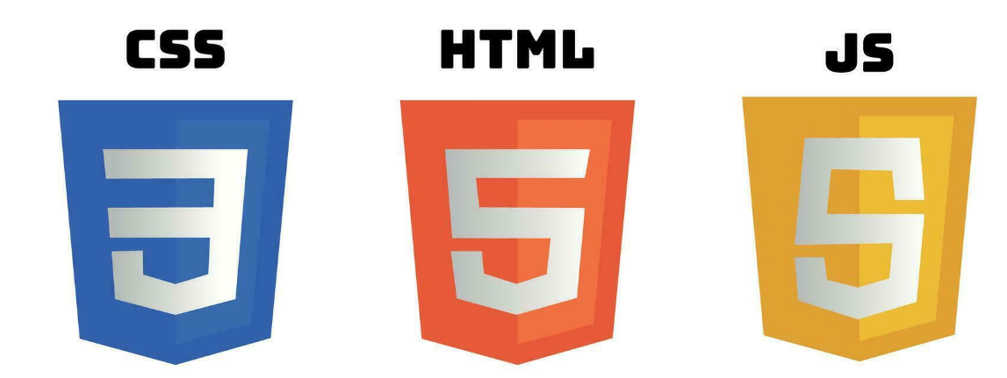
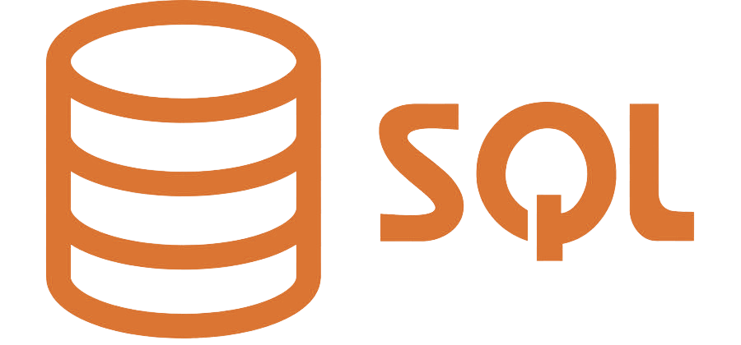



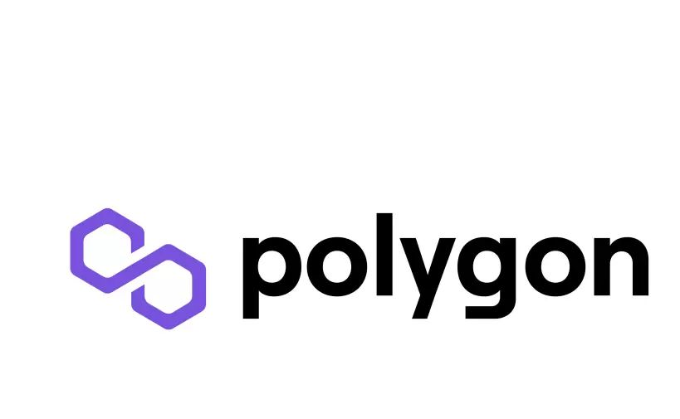

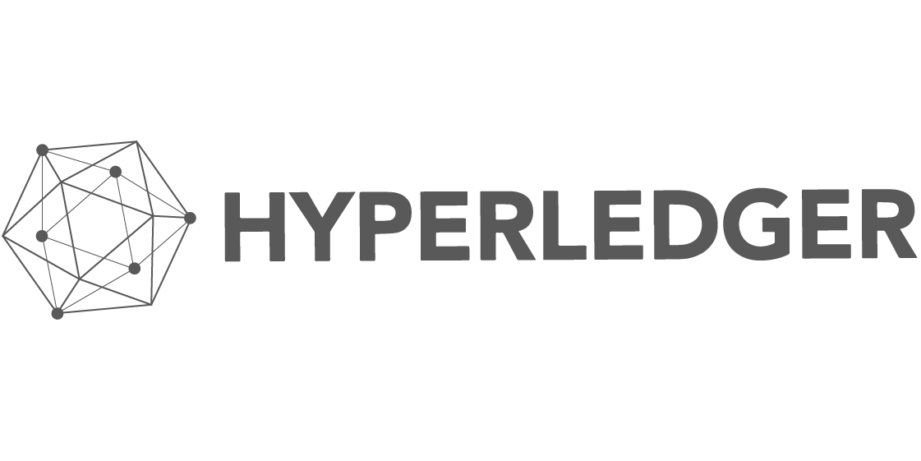


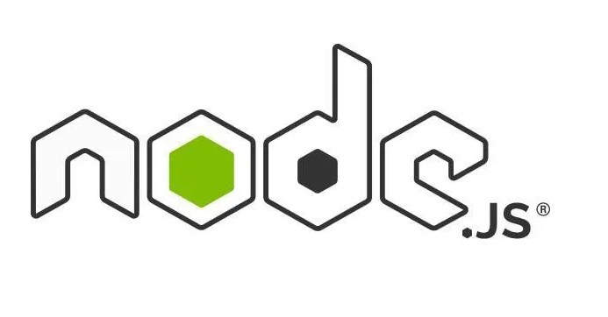

TECHNICAL APPROACH
Hack Morph
Program Architecture
Technology Used
Polygon(Blockchain):We are suing polygon to create QR code for the Block of product in the blockchain.
Hyperledger: Using this technology to create blockchain for the products info.
Frontend: HTML,CSS,JS for the Interface. Frameworks like tailwind CSS, Bootstrap.
Backend: MongoDB, react JS, PostgreSQL to power the backend and to store the Data.
QR Code Generation: Python Node.js .Use to generate the QR code so that it will become easy to Track the product details and enhances Transparency.
We are also planning for a prize prediction model using

Slide 4

FEASIBILITY AND VIABILITY
Hack Morph
Feasibility
Scalability: Blockchain + cloud + containerization ensures seamless growth as farmer participation increases.
Accuracy: Smart contracts guarantee tamper-proof records of pricing, origin, and logistics.
Proven Technology: Built on frameworks like Polygon already tested in supply chains.
User Adoption: Mobile-first design, QR scanning, and local language support encourage farmer and consumer use.
Data Security: Encrypted records + immutable blockchain ledger ensure protection against fraud.
Operational Scalability: Fits into existing FPO (Farmer Producer Org.) and mandi workflows with minimal disruption.
Potential Risks | Strategies
Low farmer digital literacy | Regional language app + voice assistant
Poor internet in villages | Offline-first app + hybrid blockchain storage
Data security concerns | AES + RBAC + permissioned blockchain
Middlemen resistance | NGO/government incentives + consumer demand
Viability
Scalable Infrastructure: Optimized for cloud + low-cost hardware (Raspberry Pi at rural hubs).
Lower Costs: Reduces middlemen exploitation → ensures higher income share for farmers.
Data Insights: Enables government & NGOs to analyse pricing, demand, and logistics trends.
National Standardization: Can scale into a nationwide traceability framework aligned with “Digital India” & “One Nation, One Market.”

Slide 5



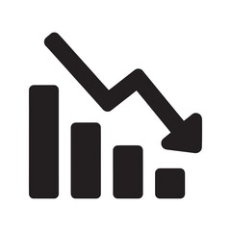
IMPACT BENEFITS
Hack Morph
BENEFITS:
1. Transparent Transactions
Payments to farmers are automatically initiated through smart contracts using recorded delivery and quality data.
No scope for manipulation; every transaction is time-stamped and can be verified.
2. Pricing Control
Farmers can price their products and post them directly on the blockchain marketplace.
Buyers view real-time prices and grades, skipping intermediaries and markups.
3. Bargaining Power
With visibility into blockchain-based market data (such as demand patterns, average prices, and buying habits), farmers are more empowered in negotiations.
Traceability verifies product quality and origin, enhancing credibility with high-end buyers.
4. Reduced Cost
No requirement for third-party verification brokers or agencies.
Automation lowers paperwork and administrative expense.
Streamlined logistics due to real-time data sharing.
IMPACTS:
Real-World Impact:
1.The smallholder farmer makes more than standard models as a result of direct sales.
Consumers trust the provenance and quality, paying premiums for third-party-verified organic or fair-trade product.
2.Spoilage and fraud reduce with open monitoring and accountability.

Slide 6

RESEARCH AND REFERENCES
Hack Morph
Research Papers:-
(PDF) Applying Blockchain in Agriculture: A Study on
Blockchain Technology, Benefits, and Challenges
2. https://share.google/tyFSBbyPnUhvmR7M6
3.https://agriculture.vikaspedia.in/viewcontent/agriculture/ict-applications-in-agriculture/blockchain-in-agriculture?lgn=en
4. https://www.leewayhertz.com/blockchain-in-agriculture/#Updated:BLOCKCHAININAGRICULTURE%E2%80%93IMPROVINGAGRICULTURALTECHNIQUES-UseCase1:CropandFoodProduction
5. https://www.fao.org/familyfarming/detail/en/c/1200090/
6. https://www.linkedin.com/pulse/future-indian-agriculture-powered-blockchain-hegde-subbarao
7. Data set-https://www.agmarknet.gov.in/
Prototype-Link/Video-
Report-

